Slide 1
Healing haunted histories
A Case Study of Native, Settler, and Queer America
in Champaign County, Illinois
Week 5/6: The Landlines and Bloodlines of Robert Allerton
Developed by Eileen Gebbie, MA, MDiv for The BTS Center Leadership Commons (2022)

Slide 2
Introductions
What is your preferred name?
Did you take any of last week’s questions back to your own families/bloodlines?
What did you learn?

Slide 3
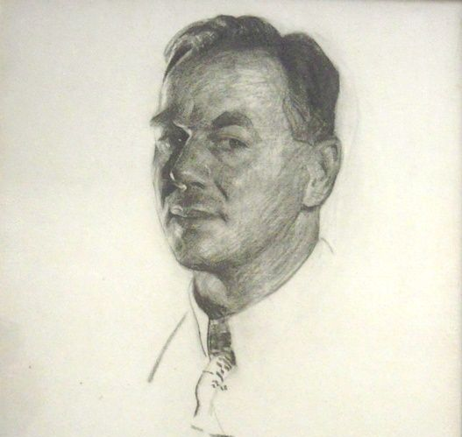
Landlines and Bloodlines of Robert Allerton
Born in Chicago in 1873
Father Samuel Waters Allerton was 45 and wealthy
35 years after the Potawatomi Trail of Death
26 yeast since Robert Hutchinson died
Only eight years after the end of the American Civil War

Slide 4
Landlines and Bloodlines of Robert Allerton
Grew up on affluent Prairie Ave.
Attended prep schools in Chicago and on the East Coast
Best friends with the True Value Hardware heir

Slide 5
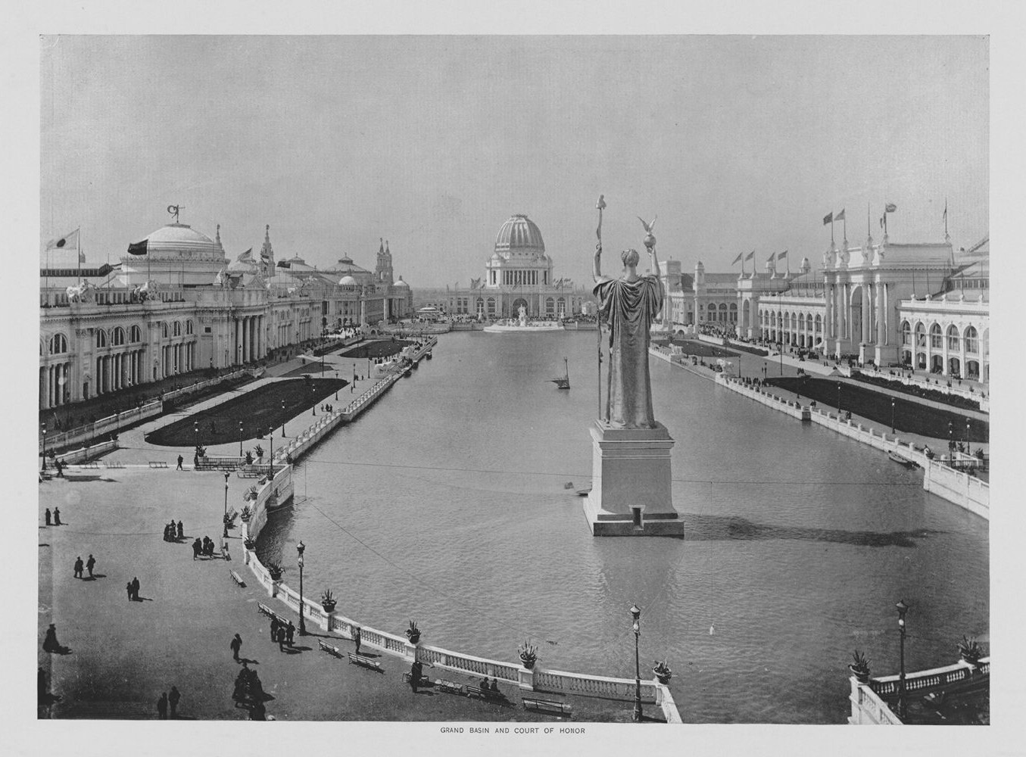
Landlines and Bloodlines of Robert Allerton
Attended the 1893 World’s Columbia Exhibition near his home
Celebration of the 400th anniversary of the arrival of Columbus
Robert was 20.

Slide 6
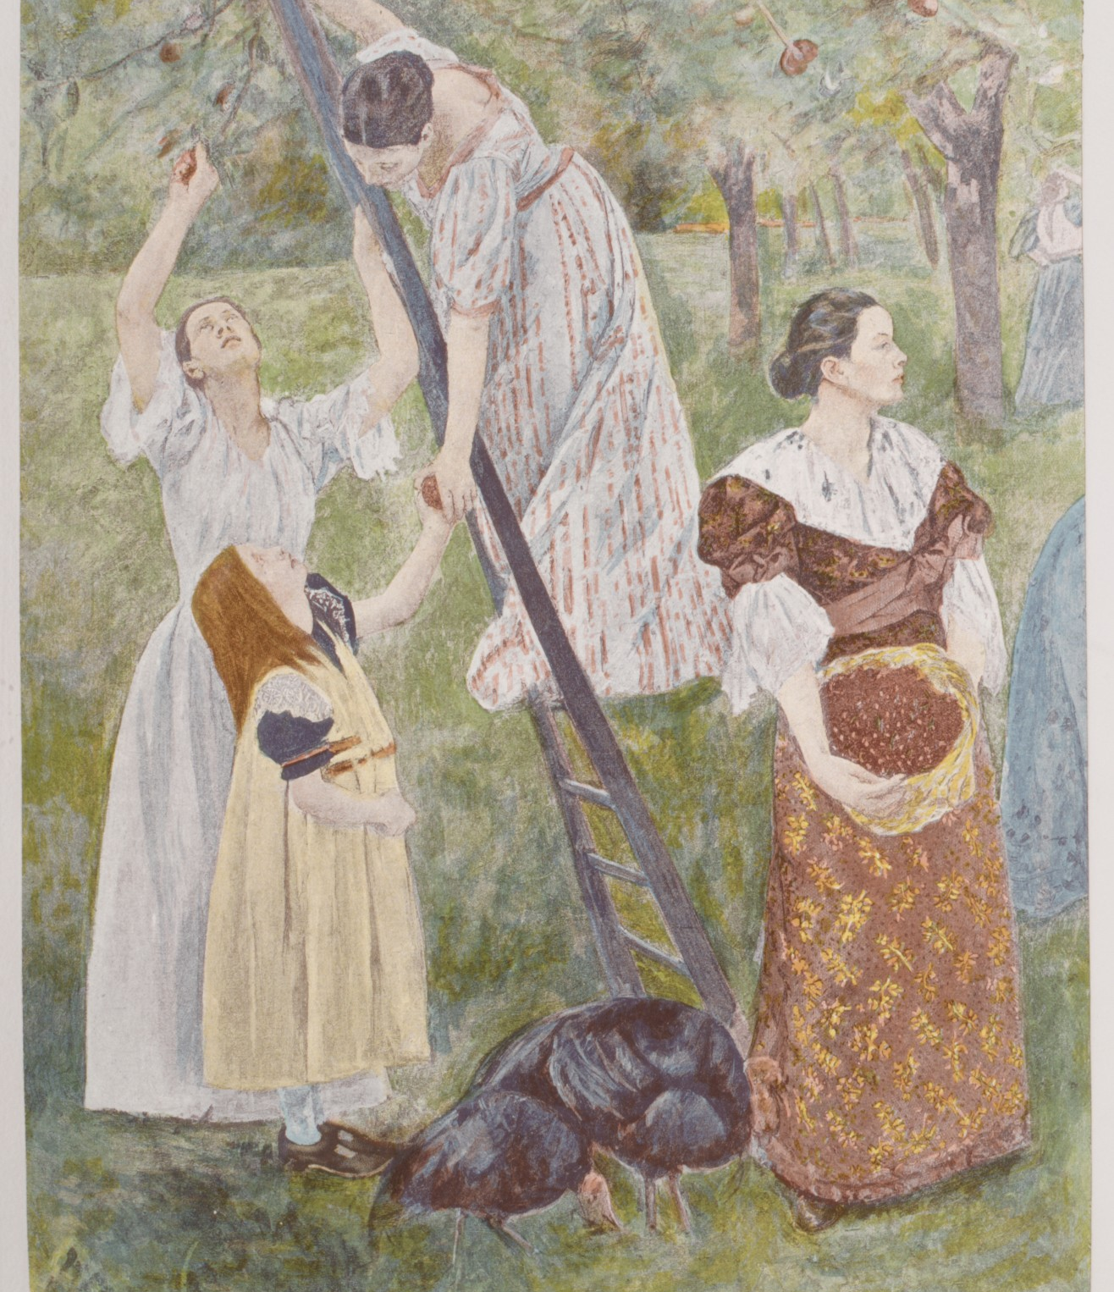
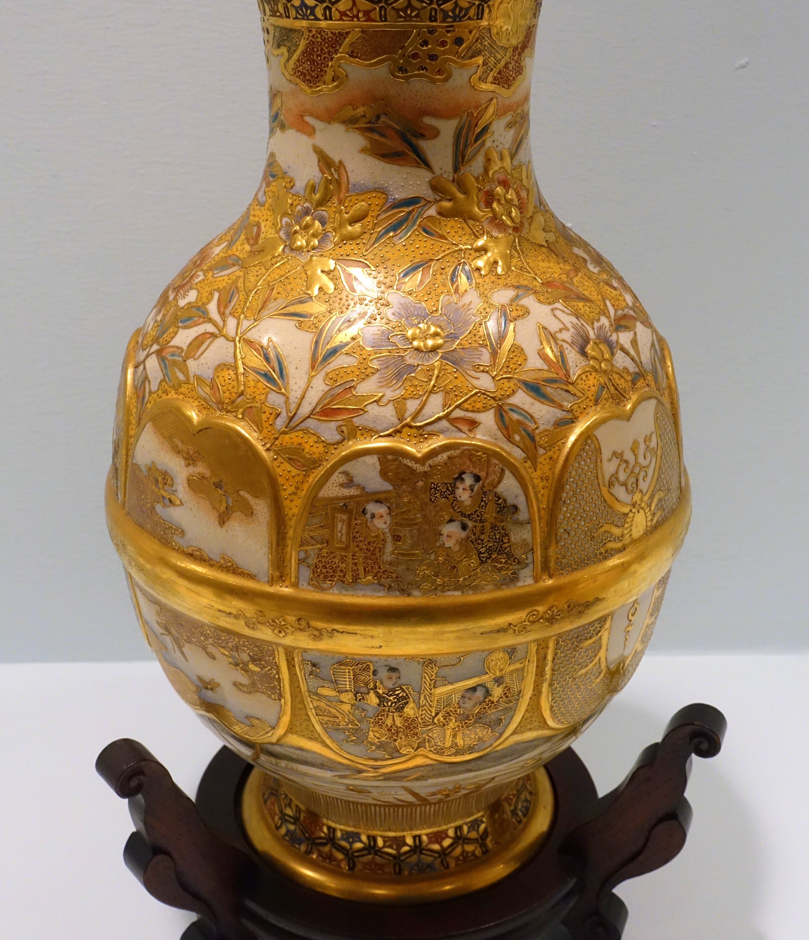
Landlines and Bloodlines of Robert Allerton
Moved by the art exhibition, Robert gives up on a plan to join Samuel’s business in order to go to art school.
These pieces are among those that were on display.
The two vases were later purchased by Robert and donated to the University of Illinois.

Slide 7
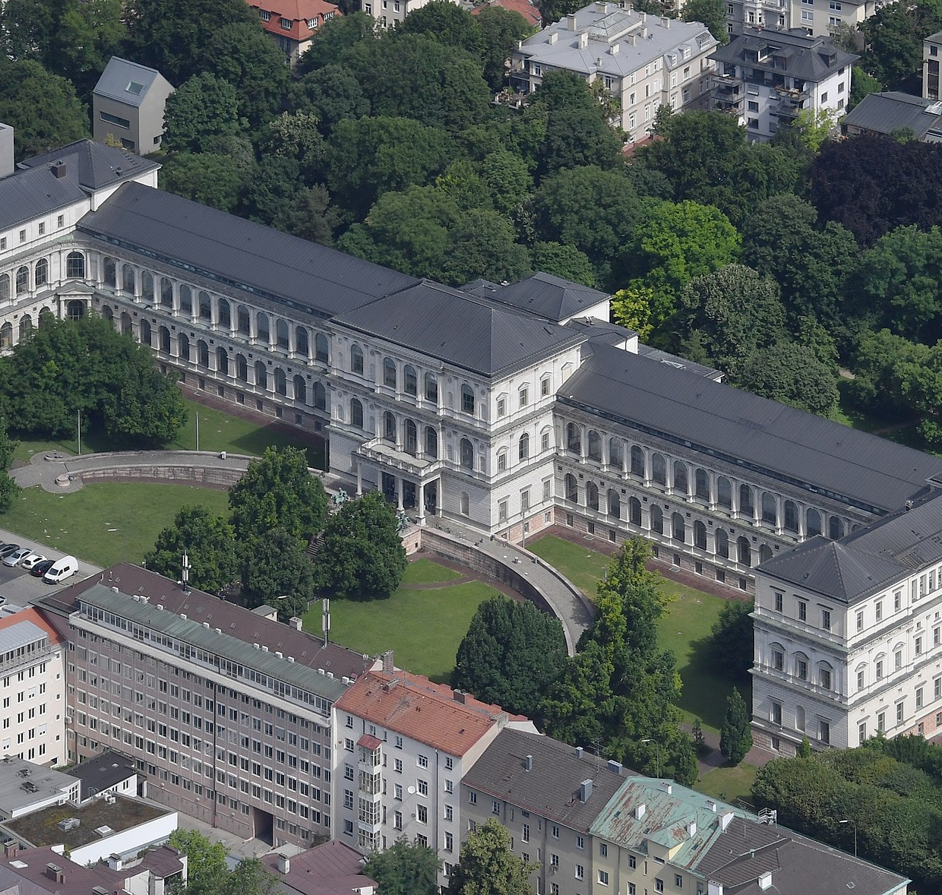
Landlines and Bloodlines of Robert Allerton
For five years, Robert studied painting, drawing, and sculpture at Munich’s Royal Academy of Fine Arts and academies in Paris.
At that point he decided he would never be a great artist and destroyed his work.

Slide 8
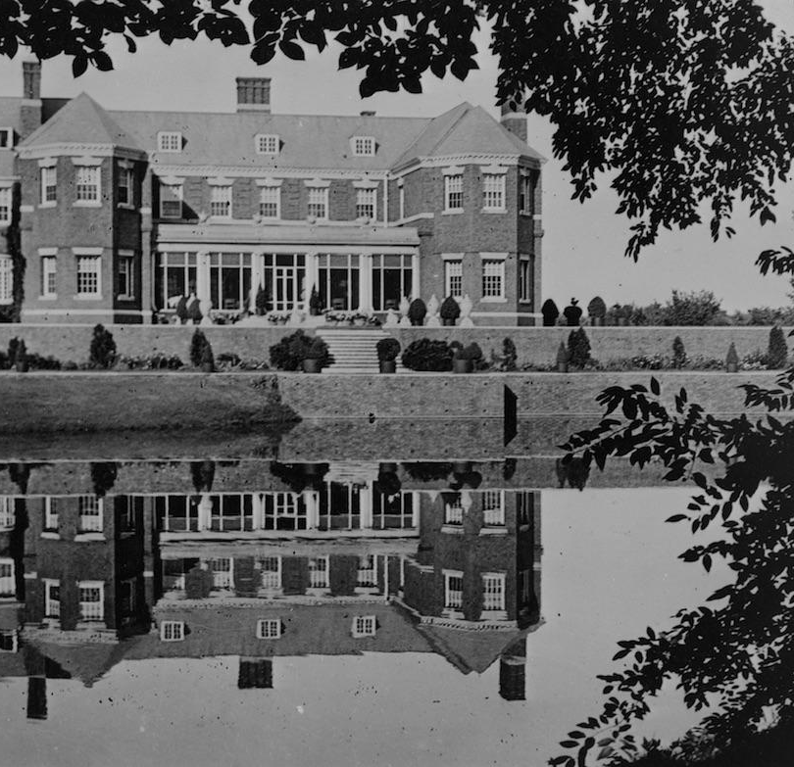
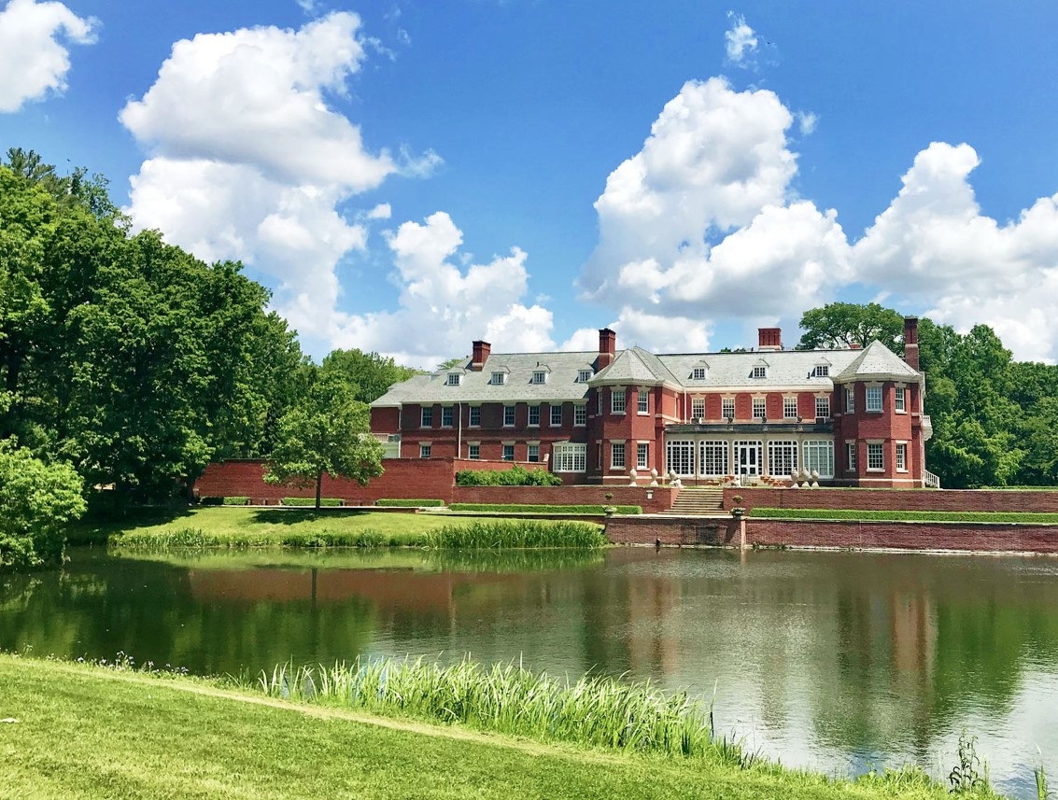
Landlines and Bloodlines of Robert Allerton
Robert took on the family land in Illinois contingent on Samuel giving Robert the money to build this home in Piatt County.
With $50,000 ($1,773,880 today), Robert studied architecture in England then built this mansion in 1900 (color image of it today).
The estate became a model of production farming that attracted experts from around the world

Slide 9
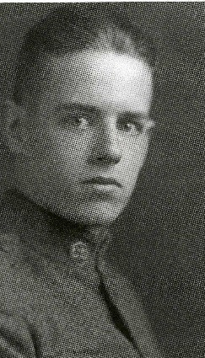
Landlines and Bloodlines of Robert Allerton
Robert, a part of the University of Illinois Campus Plan Commission since 1919, met John Gregg at a U of I “Dad’s Day” event in 1922.
Robert stood in as John’s father since John’s own parents had died.
One of John’s many campus memberships included the campus chapter of the Klan.
Said John in 1984: “Robert Allerton was invited over there for lunch before a football game and he didn't have a son and I didn't have a father, so we were paired off and lived happily ever after.”

Slide 10
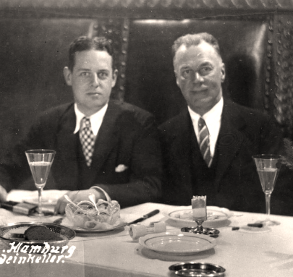
Landlines and Bloodlines of Robert Allerton
Robert Allerton was invited over there for lunch before a football game and he didn't have a son and I didn't have a father, so we were paired off and lived happily ever after.
–John Gregg in 1984

Slide 11
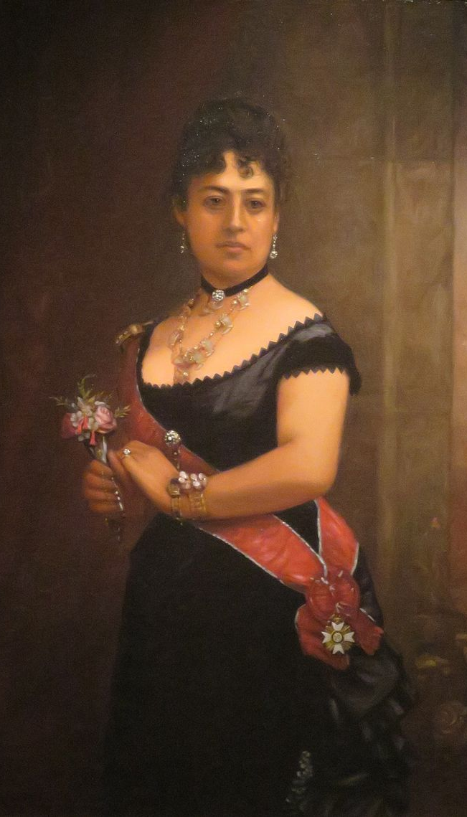
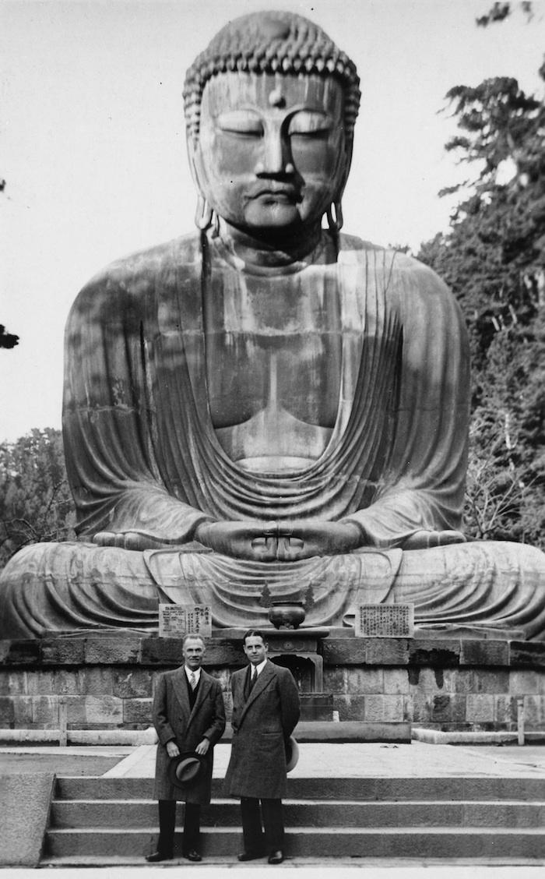
Landlines and Bloodlines of Robert Allerton
In 1938 after a trip through Asia, Robert and John purchased 300 acres on Hawai’i that had been owned by (hereditary) Queen Emma Kalanikaumakaʻamano Kaleleonālani Naʻea Rooke.
Note: The Native Hawai’ian monarchy had been overthrown by a coup orchestrated by American businessmen in 1893.

Slide 12
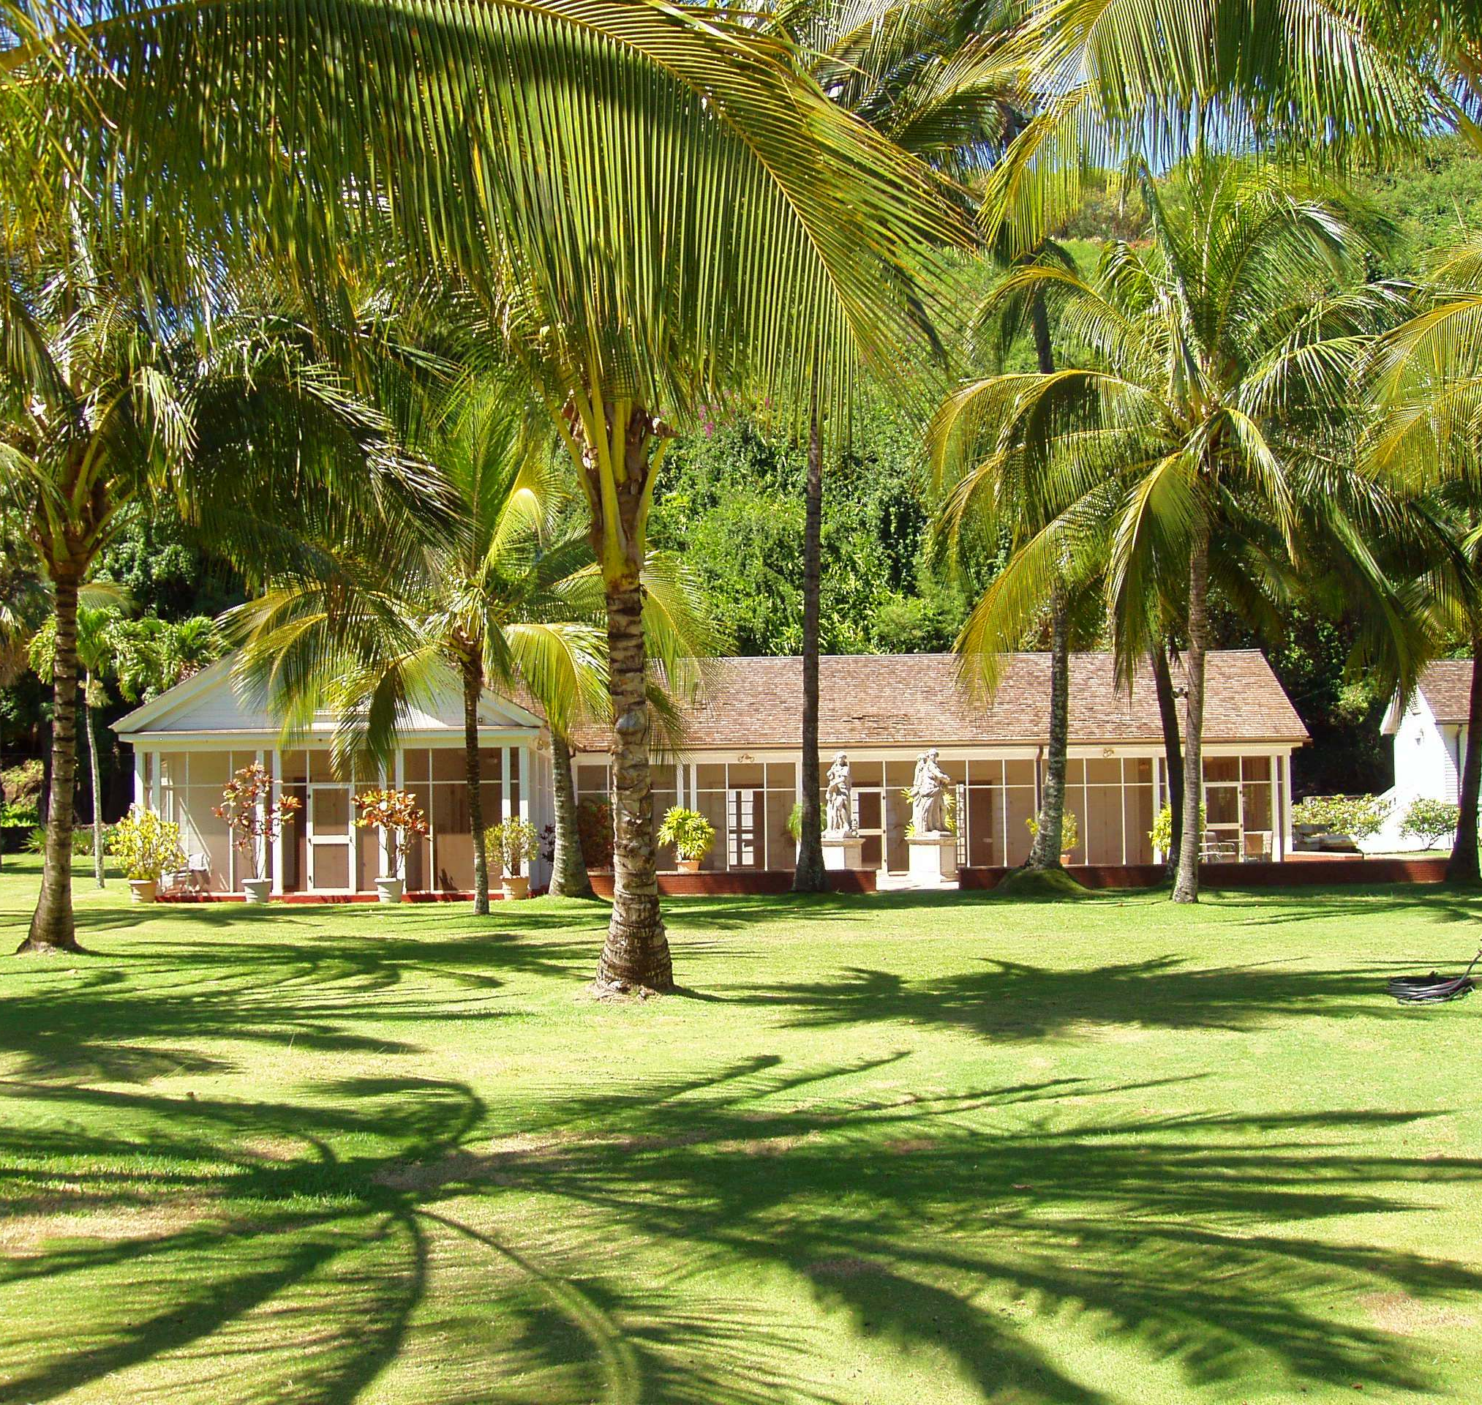
Landlines and Bloodlines of Robert Allerton
John designed the home, Lawa’i-kai, “near the ocean”
Later used in The Thorn Birds, Fantasy Island, and Raiders of the Lost Ark

Slide 13
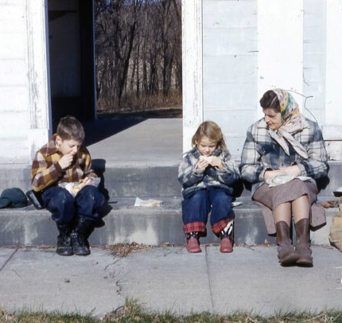
Landlines and Bloodlines of Robert Allerton
In 1946 Allerton donated the Piatt County land, which the Potawatomi crossed and on which Rebecca Peck’s first husband is buried, to the University of Illinois.
Largest donation to the campus at the time
Illinois continues to use it for research as well as recreation.

Slide 14
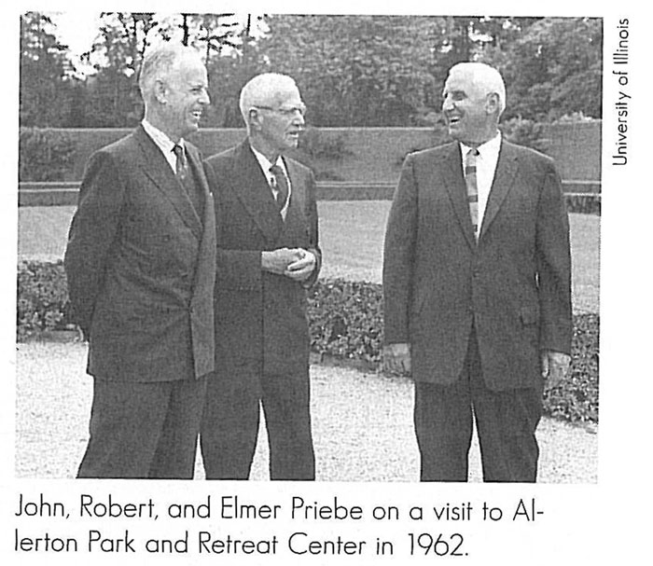
Landlines and Bloodlines of Robert Allerton
In 1960 Illinois became the first state to allow adult adoption.
Robert Allerton legally adopted John Gregg as his son, the first in the state and the nation.
This became a not-uncommon practice for queer couples prior to marriage equality.

Slide 15
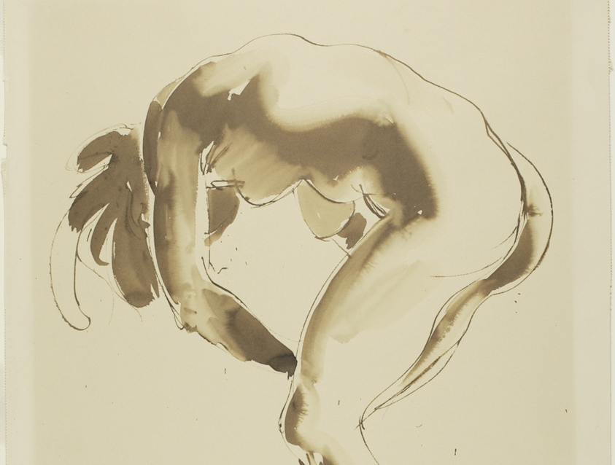
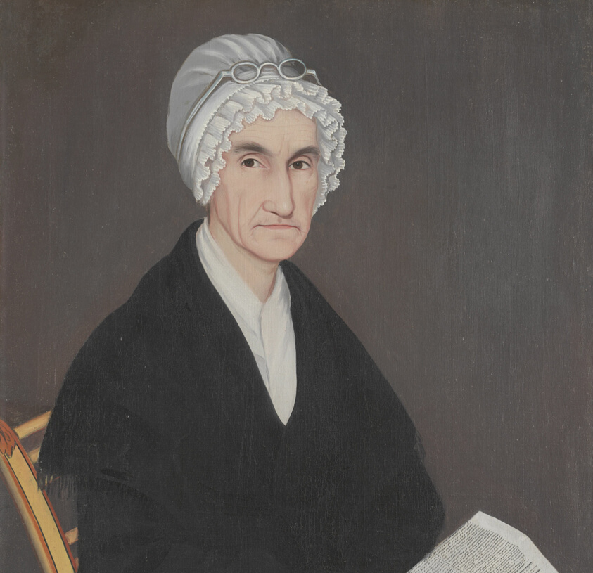
Landlines and Bloodlines of Robert Allerton
Robert studied and bought art all of his life.
He was an honorary president of the Art Institute of Chicago, and the main building is named after him.
Robert donated over 6,600 pieces, making him the top donor in their history.

Slide 16
Landlines and Bloodlines of Robert Allerton
Together with others, John and Robert successfully lobbied Congress for the creation of a National Tropical Botanical Garden.
Created in 1986

Slide 17
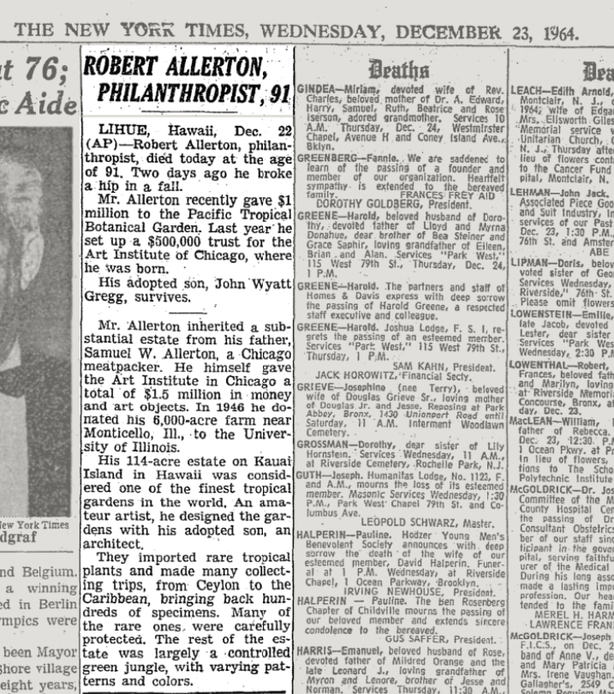
Landlines and Bloodlines of Robert Allerton
Robert died that same year.
The Hawai’ian property went to the botanical garden, though John lived on there until his own death.

Slide 18
Space for Faith
In many ways, Allerton’s story can support the Great Man Theory of history. Do our religious traditions promote that notion? What is their relationship to singular historical males?
What do our faith traditions teach us about the unnamed and the unrecognized? Is there a scriptural story that comes to mind?

Slide 19
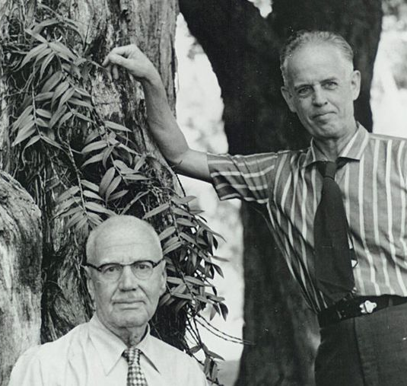
Landlines and Bloodlines of Robert Allerton
After Robert’s death in 1964 John took the Allerton name as a way to ensure that the Allerton name was imprinted on the philanthropy that John continued in the name of his adopted father.
– Allerton Park website

Slide 20
Landlines and Bloodlines of Robert Allerton
Could John’s and Robert’s story have been told differently?
What would that have “mattered”?
What does this version of the story suggest about their bloodlines?
What was at stake?

Slide 21
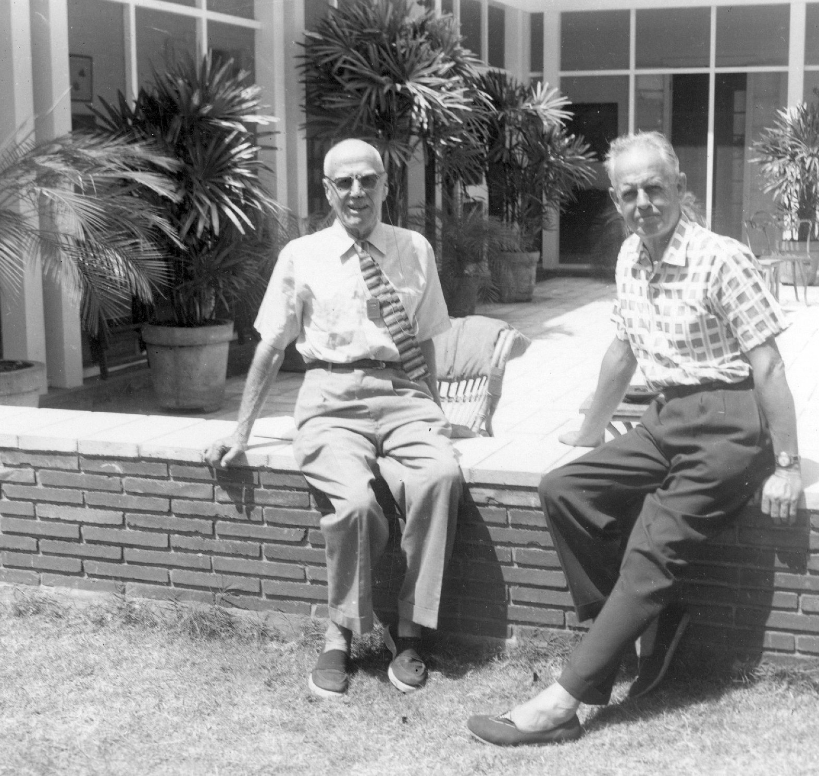
Landlines and Bloodlines of Robert Allerton
“So they meet each other in this era when homosexuality has gained much more widespread attention but in all kinds of bad ways…They are certainly capable of understanding who they are, what they are, what their love for each other means, but it’s at exactly the moment when they could never be public.
“Exacerbating this dilemma is the fact that Robert Allerton is already extraordinarily wealthy and renowned. Since he’s reported on regularly by newspapers, it means he has to account for what he does with his time. Thus, the pair required an immediate explanation.”
Nicholas Syrett, author of An Open Secret: The Family Story of Robert and John Gregg Allerton

Slide 22
Landlines and Bloodlines of Robert Allerton
How might their lives have been different if Robert and John were “out”?
How might Champaign County, IL, have been different if the largest donation the University of Illinois had received to date (Allerton Park) had come from an openly queer person?
Is there any relationship between Robert’s apparent ignorance of and/or silence about the Native lives lost on his land and his own silence?
What role might being a Mayflower descendant have had in Robert’s living? The relationship between his blood lines and landlines?

Slide 23
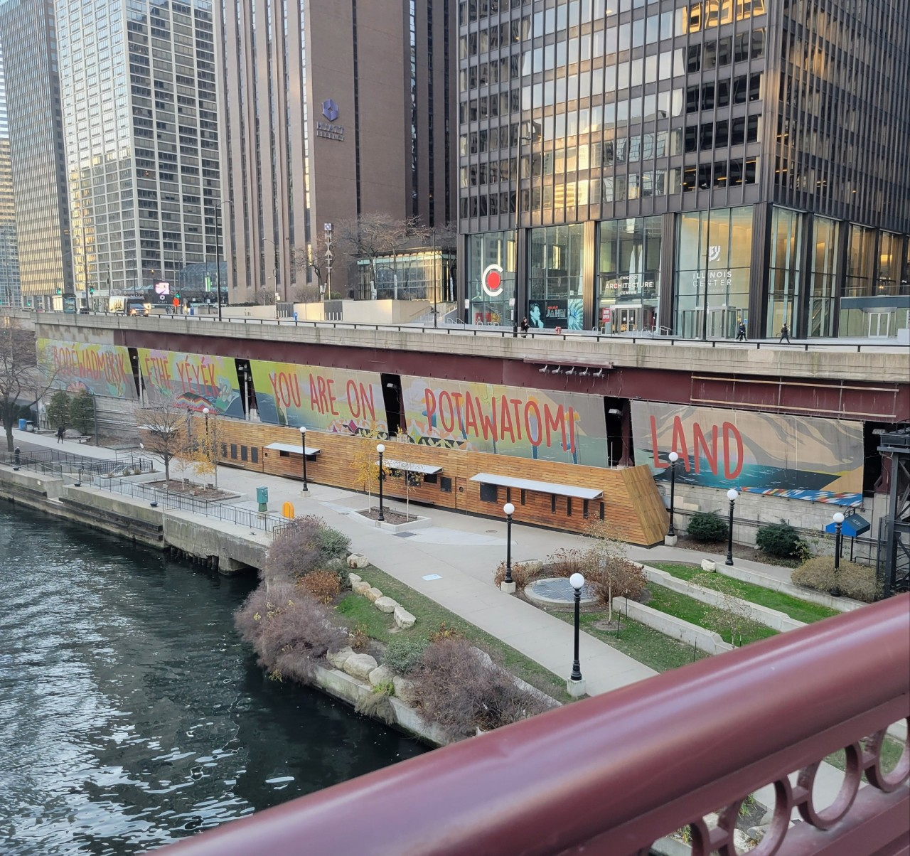
Wrapping Up
Millions of Americans have benefitted from the Allerton family’s industry and generosity.
Millions of Americans have also suffered because of that family’s industry and generosity.
How can we actively relate to those legacies, and those of barely- and unnamed Native and settler people?
Next week: Healing Haunted Histories

